Slide 1
Christmas in Czech Republic
Vánoce

Slide 2
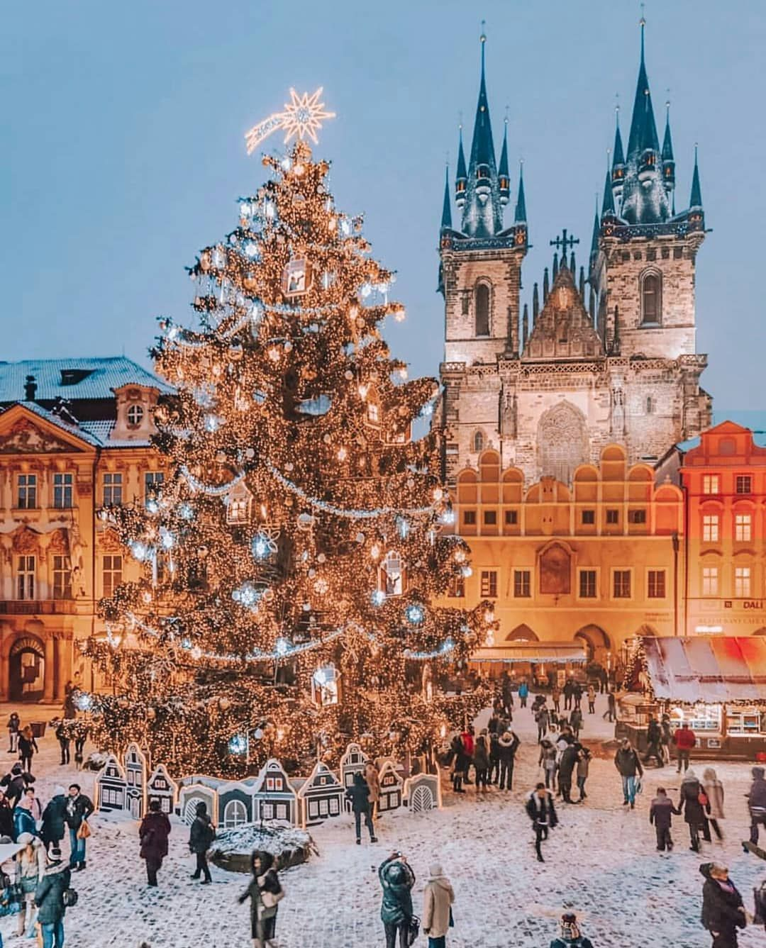
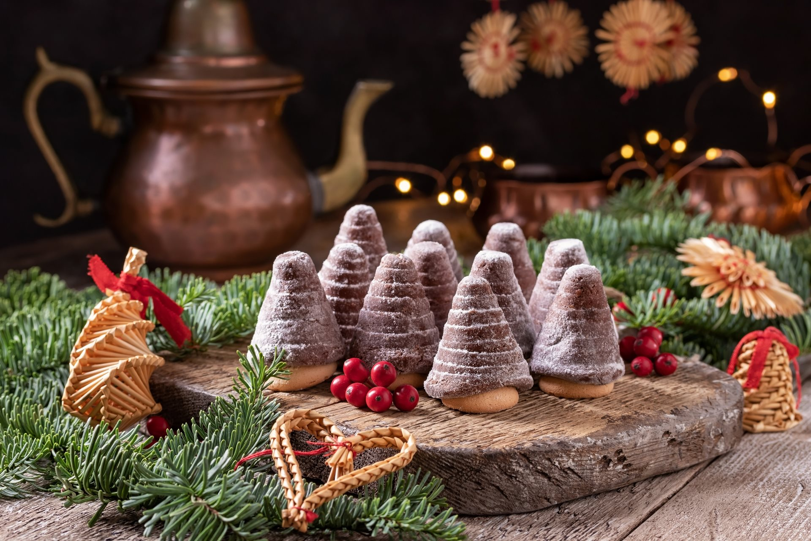
December 24
⇝ The main celebrations are on Christmas Eve
(Štědrý den “Generous day”) ⇝ Decorating the Christmas tree ⇝ One is supposed to fast to see a golden piglet,
it’s a sign of good luck
⇝ People would usually go for a walk and visit
cemetery to remember those who are no longer with us
⇝ After dinner people sing Christmas carols
⇝ December 24 is the Adam and Eva’s name day

Slide 3
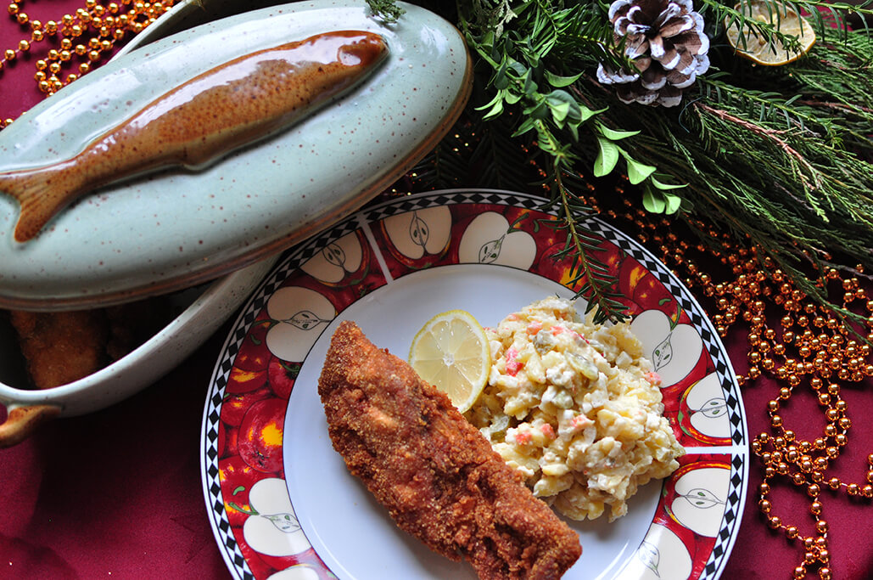
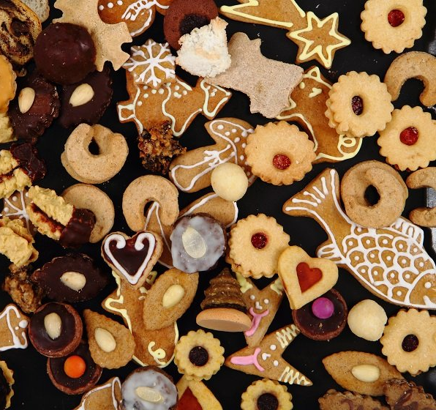
Christmas dinner
⇝ Christmas dinner should consists of nine courses ⇝ Dinner is served after the first star has appeared
on the night sky
⇝ Consists of potato salad and fried carp, often replaced by
pork or chicken schnitzel
⇝ Christmas carp is specially raised, some people keep
their carp in a bathtub
⇝ Preceded by fish soup, or alternative pea soup ⇝ People bake sweets “cukroví” and Christmas bread “vánočka” ⇝ No one should get up from the table before dinner is
finished, it’s a sign of bad luck ⇝Fish scales under tablecloth bring wealth to the house

Slide 4
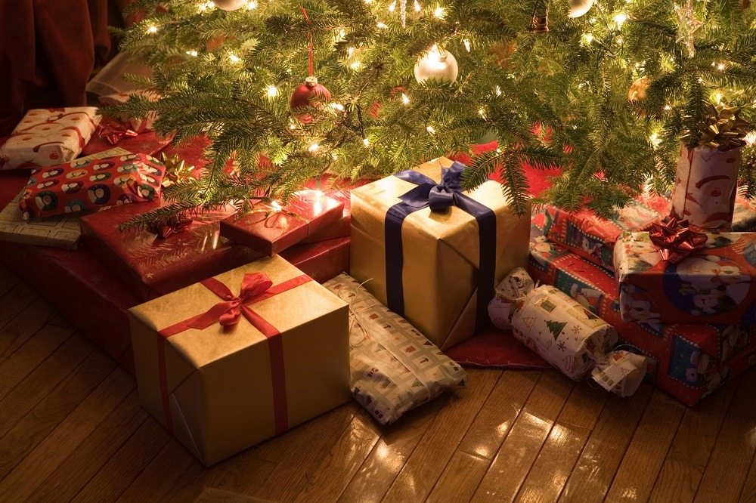
Christmas presents
⇝ After dinner and after singing Christmas carols everyone moves to the Christmas tree ⇝By then, presents have been placed under the tree
⇝ Czech children believe in Baby Jesus “Ježíšek” who comes to the room through the window ⇝Baby Jesus doesn't have particular physical image
⇝ He receives wish-list letters from children few weeks before Christmas

Slide 5
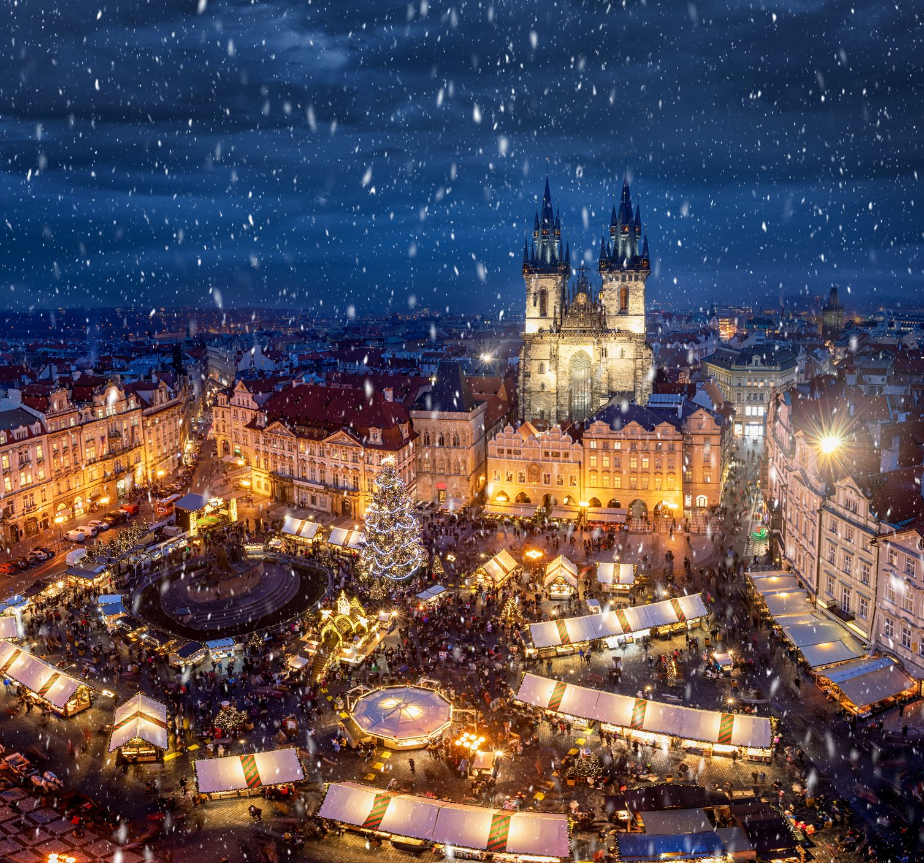
December 25 and 26
⇝ Also referred to as First and Second Christmas Holidays, or the Christmas Feast “Boží hod vánoční” and St. Stephens Day “Sv. Štěpána”
⇝ Families stay at home and relax or visit relatives and friends to share the special time
⇝ Stuffed and roasted duck, goose, or chicken, is usually served for lunch along with potato dumplings and cabbage

